Slide 1
Imaging Decisions in Pediatric Trauma
Elisha G. Brownson, MD, FACS
Trauma Medical Director
Alaska Native Medical Center
ANTHC Tribal Health Webinar Series
October 22, 2021

Slide 2
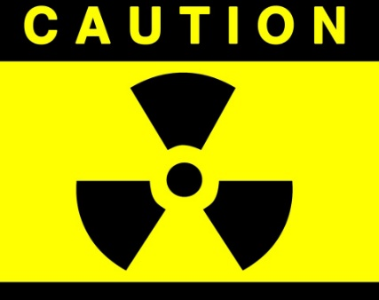
Radiation Exposure in Children
Radiation exposure from imaging increases risk of malignancy in pediatric patients
Risk of development of malignancy is 1 in 500
Risk greater for younger children (<2 years)
CTs are often calibrated for adults → higher dose than necessary
ALARA: “As Low As Reasonably Achievable”
Perform only necessary CT examinations
Adjust exposure parameters (dose and field)
Use of validated prediction tools can reduce pediatric radiation exposure for low-risk patients

Slide 3
Challenges in Reducing CTs
CT is standard of care in adult trauma care
Some data suggests “pan-scan” in adults may improve survival
Efficiency of patient workup
Desire (of provider or parent) to avoid missed injury
Lack of data to indicate patients that can be managed safely without CT

Slide 4
Trauma Imaging Decisions
Will review imaging decision making for:
Head
Neck
Chest
Abdomen/Pelvis
ANMC is a combined Adult/Pediatric Level II Trauma Center

Slide 5
Head Imaging Guidelines
Alaska state specific guidelines
Specific to rural/remote situation in Alaska

Slide 6
Adult Head Injury Guidelines Update
Ad hoc committee of Alaska TSRC in 2017; revised in 2018
17 members: ED, surgery, neurosurgery, radiology, rural family medicine, intensive care, pre-hospital care
Changes to address:
Most acute care facilities now have CT scanning available
Advances in telemedicine
Previous guidelines included children >5yo

Slide 7
Adult Head Injury Guidelines Update
Challenge to create standard guidelines that translate to all regional areas
Lack of buy-in from stakeholder groups
Need to divide out pediatrics ages 0-17
Previously >5 years

Slide 8
Pediatric Head Injury Guidelines
Ad hoc committee of Alaska TSRC in 2018; published in 2019
23 members: pediatrics, ED, surgery, neurosurgery, pediatric intensive care, pre-hospital care
Changes to address:
Previous guidelines included children >5yo

Slide 9
Pediatric Care in Alaska
Scarcity of specialty care
24-hour Neurosurgery: only in Anchorage
Pediatric intensive care
Pediatric trauma care
Two Level-II pediatric trauma centers
ANMC and Providence

Slide 10
Scope of the Problem: Pediatric
Alaska 2011-2015: 364 Children ages 0-17 with isolated blunt head injuries entered into the trauma registry
289 (80%) GCS 14,15 Mild
39 (11%) GCS 9-13 Moderate
23 (6%) GCS 3-8 Severe
(13 GCS unknown)
Notes:
Over 1 admission per day
This data analysis looked at isolated head injury (many more with multiple injuries)

Slide 11
Where are head injured patients cared for?
194 (53%) patients treated in Anchorage or Seattle
5 mortalities: all with initial GCS 3-8

Slide 12
Rural Pediatric Transfer Rate
105 patients with CT report in AK trauma registry
Mild GCS 14-15
Normal CT (28) 14% transfer
Abnormal CT (60) 65% transfer
Moderate GCS 9-13 (12) 75% transfer
Severe GCS 3-8 (5) 80% transfer
No Deaths of children kept at non-neurosurgical facilities

Slide 13
Special Considerations
Pediatrics may be difficult to examine
GCS score
Anxiety without parents/at medical facility

Slide 14
Pediatric GCS

Slide 15
Special Considerations
Adolescents
AK State Guidelines cover 0-17
Due to PECARN recommendations
American College of Surgeons age division at >14yo
Puberty changes physiology
Non-accidental Trauma
Does not apply to these guidelines

Slide 16
PECARN
Pediatric Emergency Care Applied Research Network (PECARN)
Prospective cohort study with over 42,000 children
Published in 2009
Identifies children who can safely forego head CT with very low risk of clinically significant head injury
Death
Neurosurgery
Intubation >24 hours
Hospital Admission >2 days

Slide 17
PECARN Subgroups
Younger than 2 years
Increased importance of reducing radiation
Minimal ability of children to communicate
Difference in trauma mechanisms
Ages 2-17
Difference in trauma mechanisms

Slide 18
PECARN: Ages <2

Slide 19
PECARN: Ages 2+

Slide 20
Pediatric Head Injury Guidelines

Slide 21
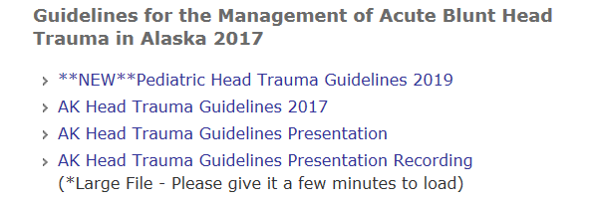
AK State Guidelines
http://dhss.alaska.gov/dph/Emergency/Pages/trauma

Slide 22
Cervical Spine Imaging
In children over 3 years, clinical exam can rule out cervical spine injury
Validated predictive tools
NEXUS*
Canadian C-spine
Children differ in that CT is NOT the imaging modality of choice

Slide 23
Pediatric C-Spine Imaging
Low incidence of injury in children
1st line is plain x-rays (no extension)
2nd line is MRI

Slide 24
Special Considerations
If CT Head is being obtained, may request C1-3 extension of field
Avoids thyroid exposure
Hardest levels to imaging in plain films

Slide 25
Cervical Spine Imaging: 0-2
Difficult to elicit physical exam
AAST Risk Score:
GCS < 14 3pts
GCS (eye) = 1 2pts
MVC 2 pts
Age > 2 years 1 pt
A risk score <2 provides a negative predictive value of 99.93%

Slide 26
Cervical Spine Imaging: 0-2
GCS < 14 or high mechanism → consider imaging
Children who meet NEXUS and have low mechanism of injury do not need imaging
IMAGING = 2-view c-spine films!!

Slide 27
Blunt Cerebrovascular Injury
Very rare in children, less than 1% (0.03 – 0.9)
Screening with CTA Neck may be considered with:
Altered mental status
Cervical fractures
Basilar skull fractures
Chest trauma
Intracranial hemorrhage
Cervical seatbelt sign (more common in kids due to improper seatbelting)

Slide 28
Considerations in Torso Imaging
When CT is required, intravenous contrast is essential
IV contrast is safe in children
Do not delay trauma scans for serum creatinine
Non-contrast scans are difficult to interpret on children
May lead to repeat imaging

Slide 29
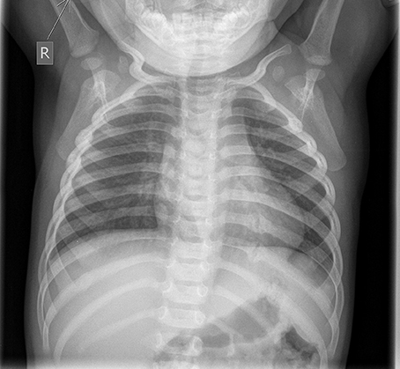
Chest Imaging
The chest radiograph is the single most valuable radiographic study in trauma
Systematic pattern for reading
For children with minor
abnormalities on chest x-ray,
chest CT is reported to have
no impact on subsequent
management
Chest CT recommended for abnormal mediastinum

Slide 30
Abdominal Imaging
Physical exam is most important
Abdominal radiograph not recommended
FAST limited in children
Lab studies to include:
LFTs
Pancreatic enzymes
Urinalysis

Slide 32
Summary
Pediatric patients who are stable should have thoughtful imaging decisions
Less radiographic exposure to achieve diagnostic results is preferred
IV contrast is safe and preferable for torso imaging

Slide 33
Alaska Trauma Care and You
Why is this important?
We are all going to take care of seriously injured patients… the question is not IF but HOW we decide to deliver care
It makes a difference in patient outcomes
It’s the standard of care you want for your family and neighbors if they are seriously injured
We want to do the best for our future generations

Slide 34
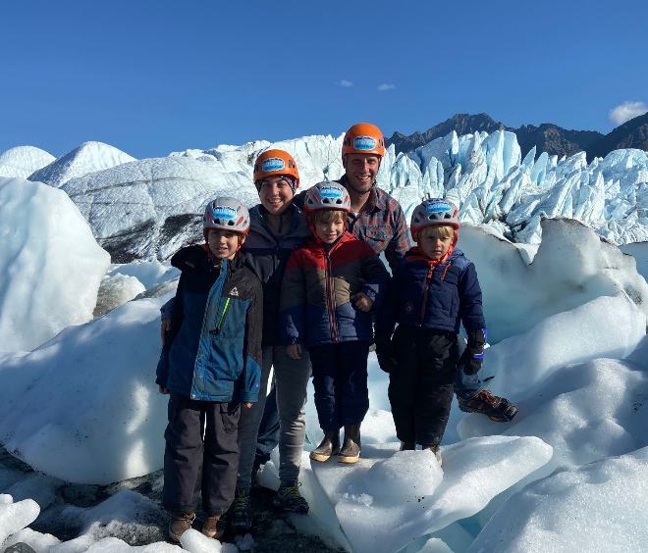
Questions?
ANMC Transfer Center: 907-729-2337
Elisha Brownson: egbrownson@anthc.org

