Slide 1
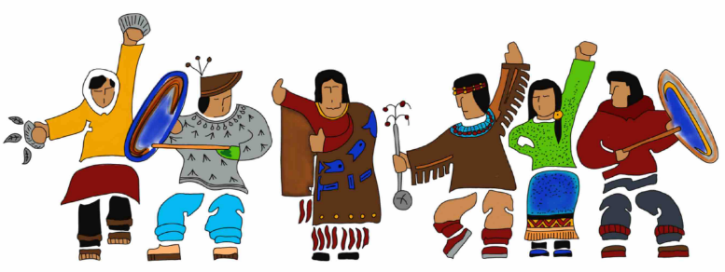
Indigenous Foods Movement in Alaska: Holistic Approaches for Nutrition & Culture

Slide 2
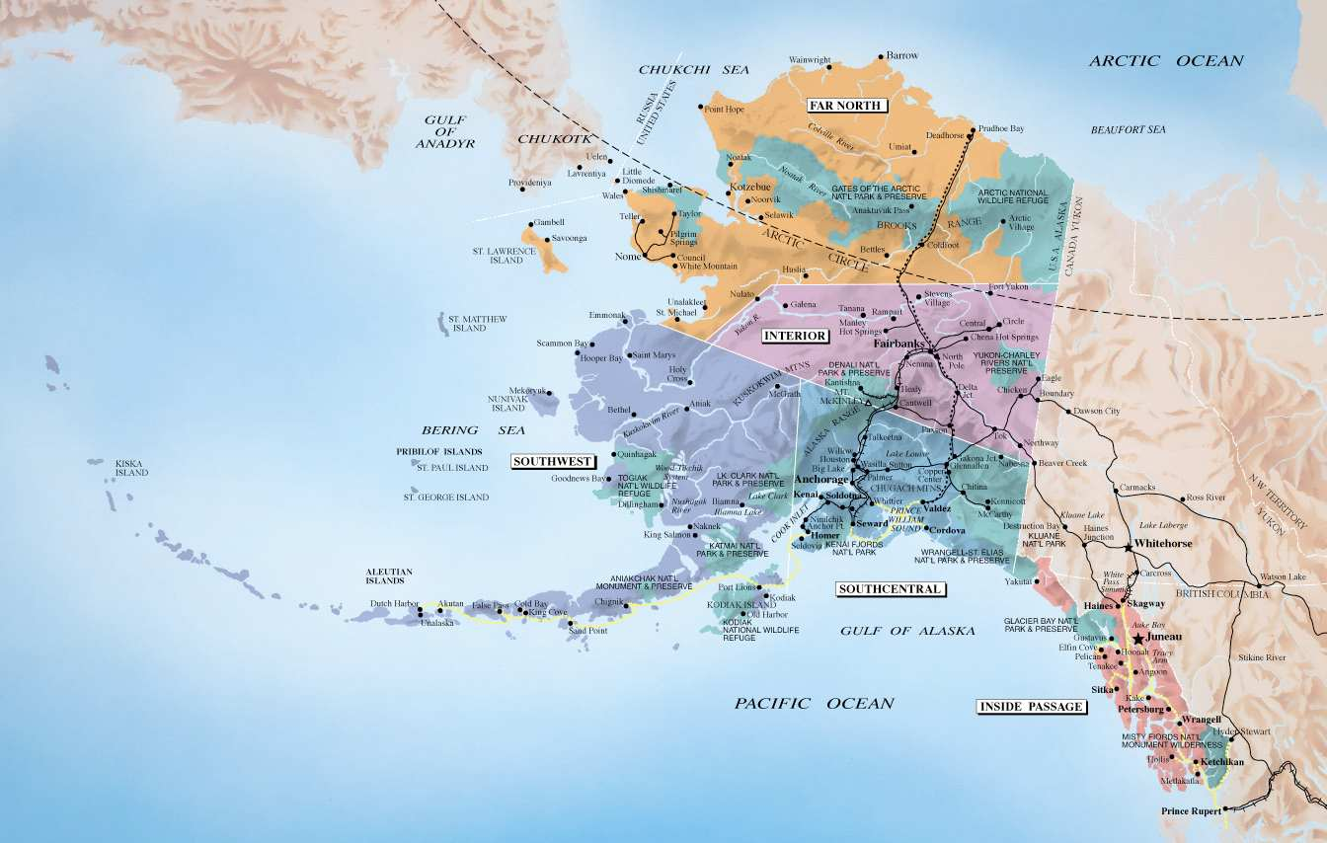
Notes:
Introduce – self (Professionally and personally)
Alaska is big and diverse state!
Map – regions
231 Federally recognized tribes in AK
Common core beliefs and values regarding culture, but still differs community to community.

Slide 3
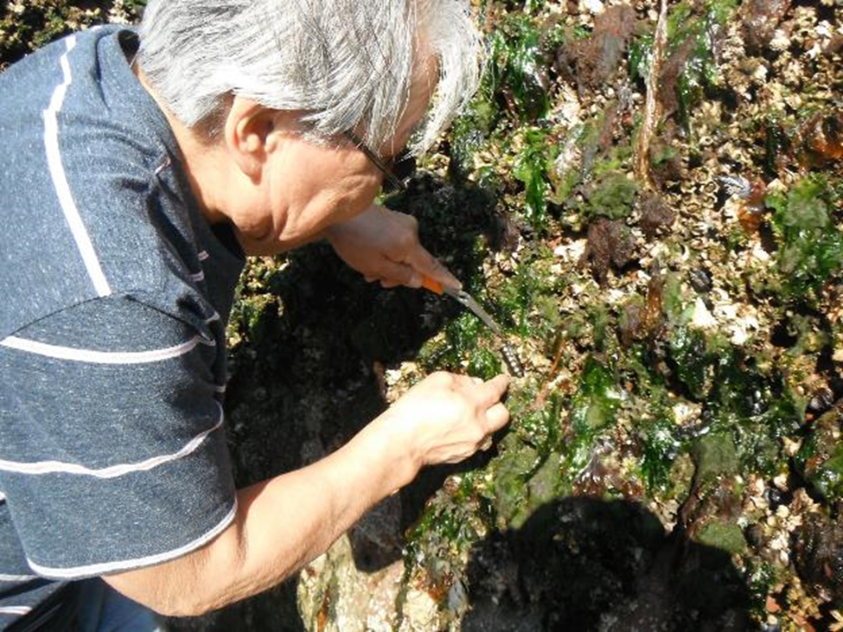
Indigenous Foods and Diabetes Prevention
Cultural Significance of Indigenous foods
Different of access between Rural and Urban Areas
Revitalization of Indigenous Foods and Subsistence Living
Holistic Impact for Individuals and Families
Notes:
Emphasize physical, mental, emotional, and spiritual wellness

Slide 4
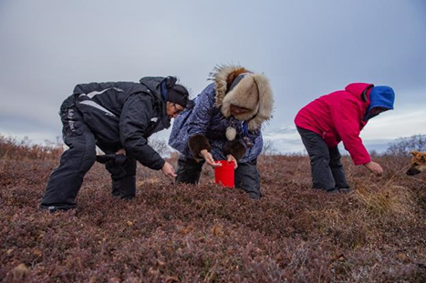
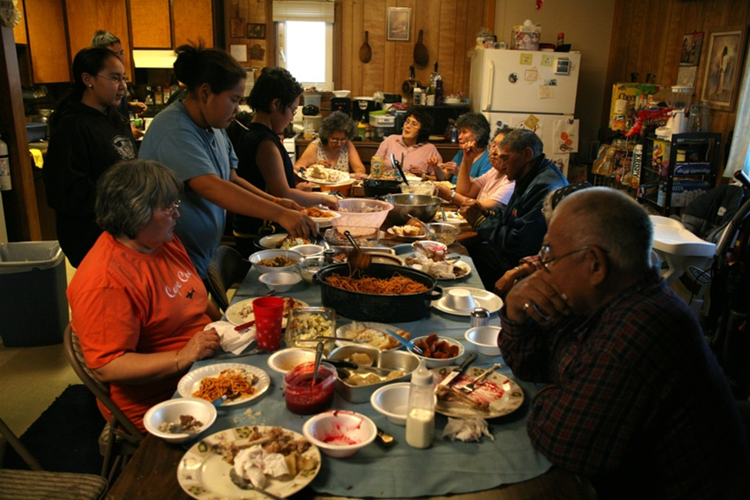
Significance of Foraging, Harvesting, and Hunting
Family or Community Effort
Building and honoring relationships
Impacts not only nutrition but mental, emotional, and spiritual health
Aids in Food Security for Families
Notes:
Spiritual = connection to the land, past family members
Personal story – sea asparagus

Slide 5
Clinical Differences for Urban and Rural Communities
Urban
Rural
Decreased access to indigenous foods
Cost of travel back to villages
Reliance on community members for access
Decreased knowledge of land – foraging, harvesting, and hunting
Decreased knowledge preparing indigenous foods
Increased access to refined and processed foods
Increased access to indigenous foods
Increased food security if indigenous foods are harvested
Increased cost of conventional foods
Rules and regulations regarding hunting and fishing for indigenous foods
Notes:
Rural – transit differences to hunt, forage, gather

Slide 6
Clinical Applications for Indigenous Foods
Assess community access for indigenous foods
Questions to Ask
How does culture influence your health?
How do you incorporate indigenous foods into meals/snacks?
Advocacy Efforts
Connect with other Stakeholders in the community

Slide 7
Cultural Awareness and More Continuing Ed
Cultural Awareness
The ability to perceive our own cultural beliefs, values, and customs, and to understand how they shape our decisions and behavior
Cultural Competence
Ability of providers and organizations to effectively deliver health care services that meet the social, cultural, and linguistic needs of the patients.
Cultural Humility
The ability to maintain an interpersonal stance that is other-oriented in relations to aspects of cultural identify that are most important to the individual
Lifelong commitment to self-evaluation and self-critique
Fix power imbalances
Develop partnerships with people and groups who advocate for others

Slide 8
Community Direction For Diabetes Prevention
Notes:
I’ll be presenting ways that Foods We Alaskans Enjoy (FWAE) cookbook can complements prevention and wellness efforts in your community.

Slide 9
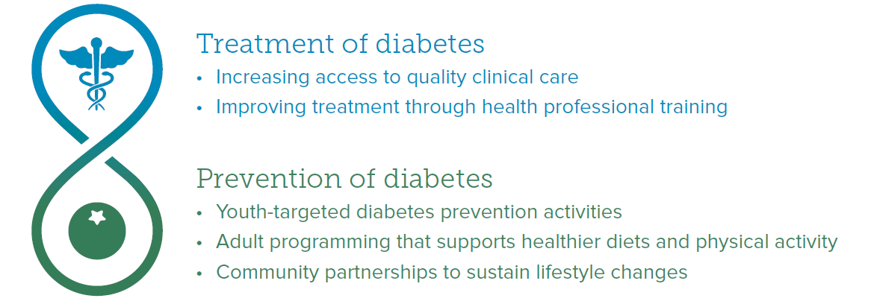
Special Diabetes Program for Indians (SDPI)

Slide 10
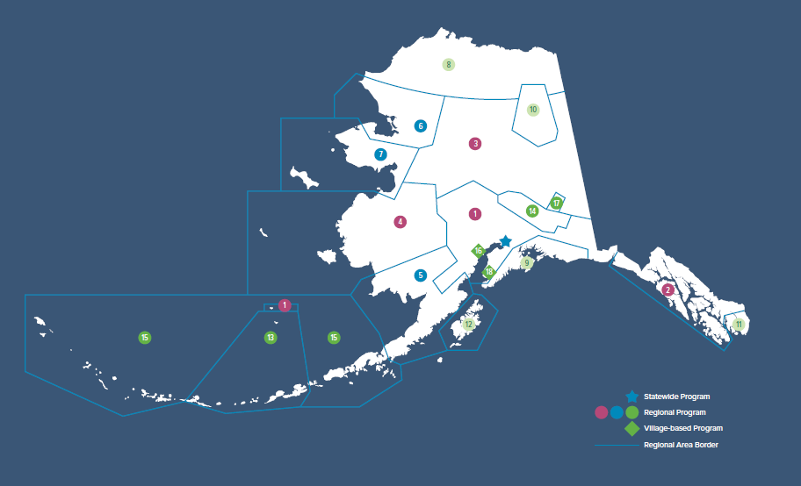
SDPI Grant Programs

Slide 11
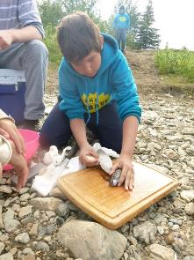
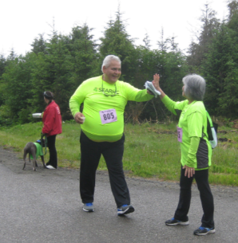
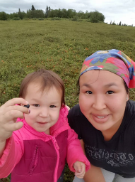
Foods We Alaskans Enjoy
Complements ongoing wellness and diabetes prevention efforts
Supports tribal efforts to reclaim and revitalize indigenous ingredients

Slide 12
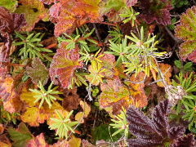
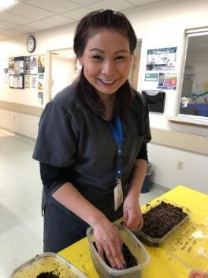
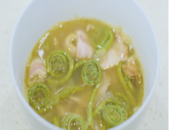
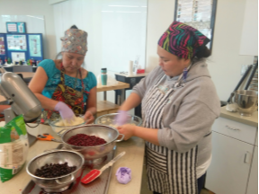
Goals
Celebrate Alaska Native indigenous foods for the ways they support wellness (body, mind, emotion and spirit) and prevent diabetes
Promote Alaska Native cultural values
Connect Alaska Native people with others who have knowledge of indigenous ingredients
Suggest non-indigenous ingredients and recipes as an alternative to processed foods
Notes:
Recognize indigenous foods satisfy and often surpass non-indigenous foods for nutrient quality

Slide 13
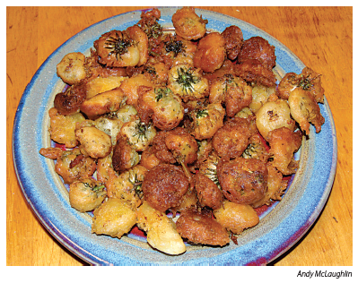
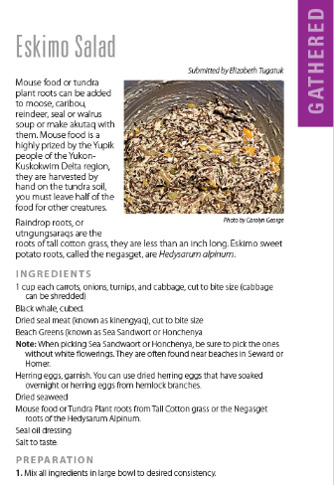
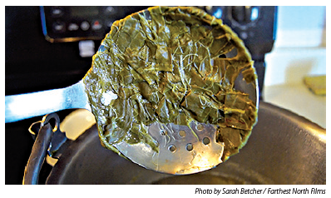
Format
6 x 9, spiral bound book
Complete recipe on 1 page or facing pages
High quality pictures and meaningful artwork throughout
5 sections – Gathered, Grown, Hunted, Fished & More Ideas – each displaying artwork and pictures of people harvesting or preparing food
Page printed tabs
Notes:
It’s small but inspiring and many people contributed to the work by submitting well loved recipes, photos that showed steps in the process or the prepared dish.

Slide 14
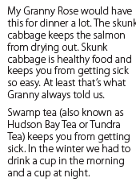
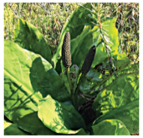
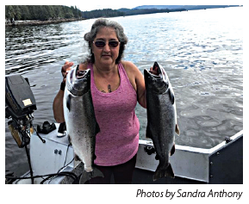
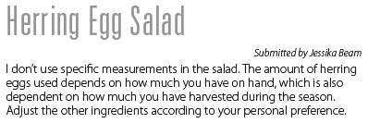
People Connections
Intentionally identify contributors and people by name to facilitate connections statewide
Provide space for sharing personal meaning

Slide 15
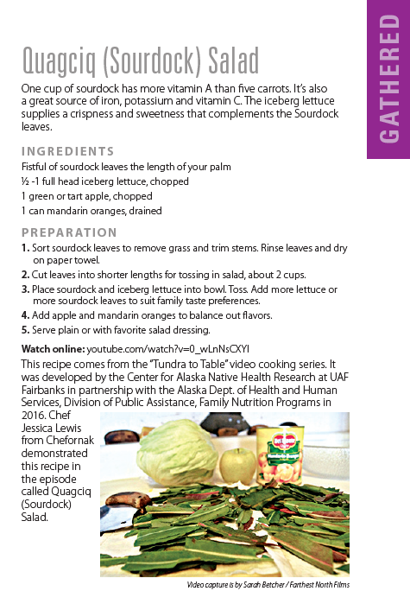
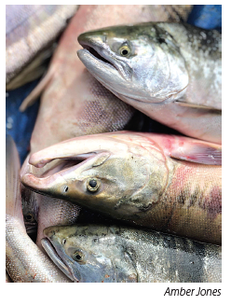
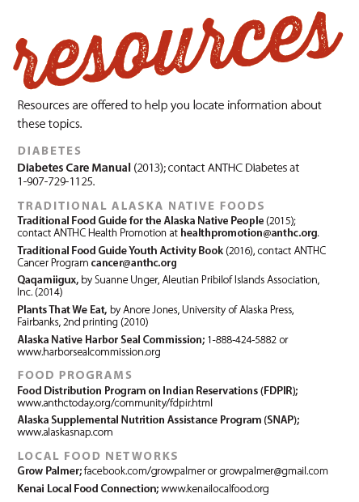
Program Connections

Slide 16
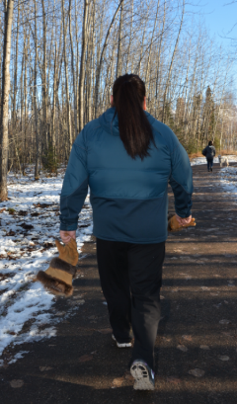
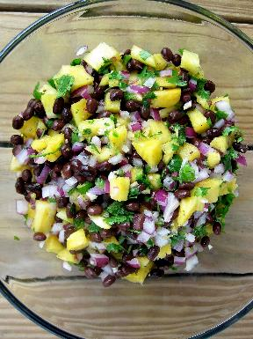
Community Walks
Notes:
A number of tribal partners organized community walks and challenges. When you outline a prescribed walking route, you can also arrange for prepackaged snacks and photo opportunities. The last cookbook section provided recipes that were healthy alternatives to processed snacks and foods high in fiber or protein or made with canned fruits and vegetables.

Slide 17
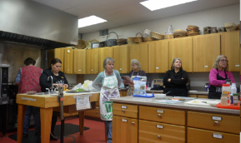
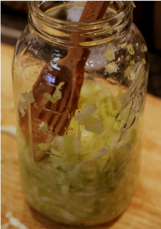
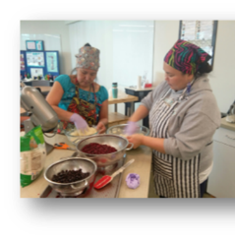
Cooking Demonstrations
Ingredients
Supplies
Recipes
Contests
Notes:
The pandemic has increased people’s interest in cooking videos and demonstrations. The prepared recipe can be offered at a lunch program. Zoom workshops or videos teach how to prepare recipes included in the cookbook. Either way, SDPI partners encourage community members to make the recipe themselves at home, by purchasing ingredients and supplies for those recipes. The picture on the right is a fermented sauerkraut recipe included in the cookbook. A contest sharing the prepared recipe is another great follow up.

Slide 18
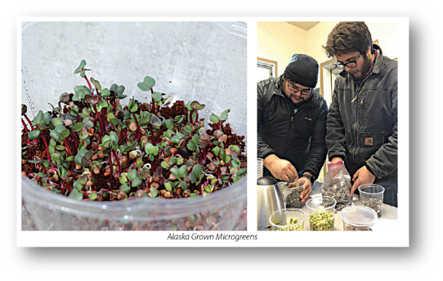
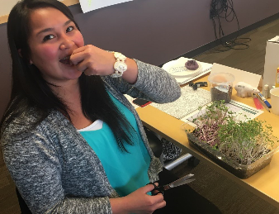
Growing Food (Microgreens)
Recipes
Seeds
Coir
Notes:
The pandemic has heightened interest in food security. Many communities organize microgreen growing activities to help people stay engaged with the growing cycle. SDPI monies allow for the purchase of supplies to grow microgreens. Microgreens are baby vegetables that can be eaten in a few days to a week after planting. They can be grown all year long. FWAE recipes that make use of microgreens can be found on p. 41, 44 and 88. And full instructions for growing microgreens is found in the last section.

Slide 19
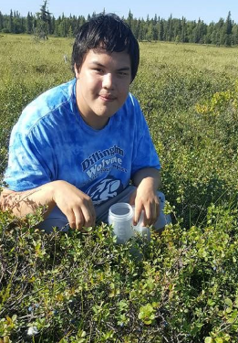
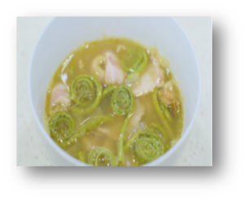
Plant Gathering
Collecting bags
Berry buckets
Stickers
Recipes
Ingredients
Notes:
Plant walks are great activities that can connect youth and elders. You can give kids a collecting bag and send them out with an adult to gather the plants and then bring the plants back to a community feeding site or school cafeteria to preserve them or prepare in a recipe; such as the one for black-eyed pea soup with fiddleheads included in the cookbook. Youth can then share the preserved ingredients or prepared food with elders. Elders may also enjoy a copy of the cookbook.

Slide 20
Thanks for all the good work that you do!
Luz Smeenk, MS, RD, LD
Community Educator
ANTHC Diabetes Program
lmsmeenk@anthc.org
907-729-3925

Slide 21
Indigenous foods in our hospital

Slide 23
FOOD REGULATIONS
The Agriculture Act of 2014 passed the Senate with an overwhelming bipartisan majority of 68-32 on Feb. 4, 2014; signed into law on Feb. 7, 2014
Supported by former Alaska Sen. Mark Begich and Dr. Ted Mala
Included Sec. 4004: Food distribution program on Indian reservations
Sec. 4033: Service of traditional foods in public facilities
The term “food service program” includes:
Food service at residential child care facilities that have a license from an appropriate State agency
Any child nutrition program, food service at hospitals, clinics and long-term care facilities and senior meal programs.
2014
FARM BILL
2018
U.S. Code Title 25. Indians- Chapter 18. Indian Healthcare-Subchapter VI Miscellaneous Section 1685

Slide 24
Alaska State Food Code & Municipality of Anchorage
Traditional wild game meat, seafood, plants and other food donated to an institution or a nonprofit program.
Includes residential child care facility with a license from the DHSS, school lunch program and senior meal program.
Food must be whole, gutted, gilled, as quarters or roasts without further processing.
Animal is not diseased, food is butchered, dressed, transported and stored to prevent contamination, undesirable microbial growth or deterioration
Prohibited food
Molluscan shellfish, unless the operator complies with 18 AAC 31.200(c)(6) and (d) and 18 AAC 31.335
Fox, polar bear, bear and walrus meat
Seal or whale oil, with or without meat
Fermented game meat (beaver tail, whale flipper, seal flipper, maktak and walrus)
Fermented seafood products (salmon eggs, fish heads and other)
Homemade canned or vacuum sealed foods
Smoked or dried seafood products, unless those products are prepared in a seafood processing facility permitted under 18 AAC 34

Slide 25
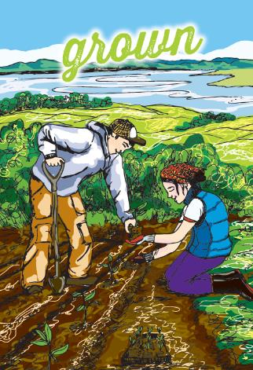
ANMC Healing Garden Tyonek Garden Seeds Of Change Alaska Alaskan Grown Pilot Program with APU Farm
Dandelion Roots, Greens and buds, Sorrel, Lovage, Kale, Onions, Cabbage, Carrots

Slide 26
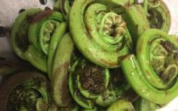
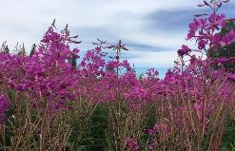
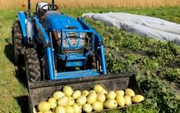
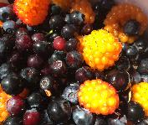
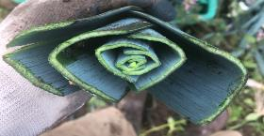
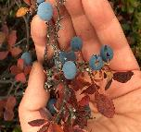
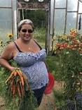
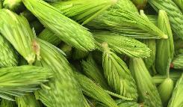
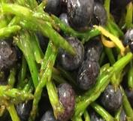
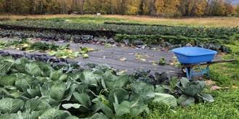

Slide 27
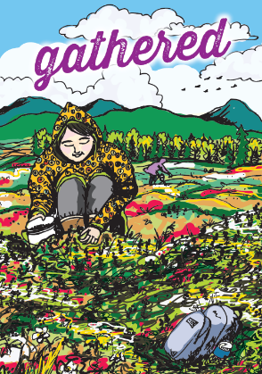
Alaskan Blueberries
Fiddlehead Ferns
Spruce Tips
Beach Asparagus
Salmon Berries
Cloud Berries
High Bush Cranberries
Lowbush Cranberries
Beach Green
Bull Kelp
Seaweed
Labrador Tea
Birch Tree Sap
Fireweed

Slide 28
Wild Caught Salmon
Salmon Heads
Herring Eggs
Salmon Bellies
Halibut
Cod
Hooligan
Sheefish
Salmon Roe
Whitefish

Slide 29
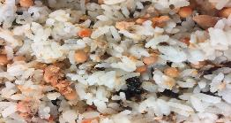
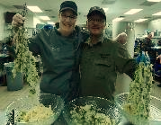
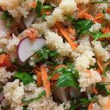
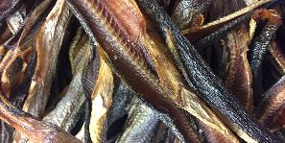
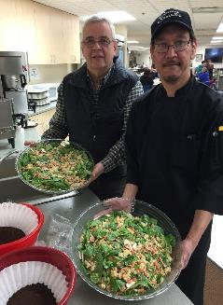

Slide 31
Reindeer
Moose
Caribou
Blacktail Deer
Harbor Seal

Slide 33
Grand total of Donations 25,787 pounds over 12 tons

Slide 34
CARING DURING COVID 19
Patient Menu
Moose Stew
Tundra Meat loaf
Reindeer Stroganoff
Baked Cod
Baked Sheefish with Pickled Beach Asparagus
Bone Broth
Salmon Chowder
Traditional Tuesday
Seal soup
Moose stew
Caribou stew
Fish head soup
Salmon belly and roe soup with bull kelp
Fishy Friday
Smoked Hooligan, Salmon or Sheefish
Fried Hooligan
Sweet Treat Saturday
Birch sourdough bread with fireweed jelly
Rhubarb bread
Crab apple pudding
High bush cranberry pudding
Blueberry pudding

Slide 35
“Let food be thy medicine, and let medicine be thy food.”
-Hippocrates

Slide 36
Luz Smeenk, MS, RD, LD
Community Educator
Alaska Native Tribal Health Consortium Diabetes Program
3900 Ambassador Drive, Anchorage, AK 99508
lmsmeenk@anthc.org
907-729-3925
Amy Foote | Area Executive Chef , CDM, CHESP
NMS | Alaska Native Medical Center
Direct 907 729-2681 | Cell 907 575-3486 | Amy.Foote@nmsusa.com
Seth Newt Anderson MS, RD, LD
Outpatient Dietitian
Southcentral Foundation Primary Care Clinics
4200 Ambassador Drive, Anchorage, AK 99508
SNAnderson@scf.cc
907-729-3179
Nativefood4life@anthc.org
to donate traditional foods

