Slide 1
The 50-year report on cancer among Alaska Native people
Sarah Nash, PhD MPH CPH
Alaska Native Tumor Registry
Clinical Directors’ meeting
May 6th 2021

Slide 2
1 in 5 deaths among Alaska Native people is due to cancer
Source: State of Alaska Bureau of Vital Statistics; Alaska Native EpiCenter Alaska Native Mortality Update 2004-2011

Slide 3
Cancer is the third leading cause of Years of Potential Life Lost, accounting for 12%
Source: State of Alaska Bureau of Vital Statistics; Alaska Native EpiCenter Alaska Native Mortality Update 2004-2011

Slide 4
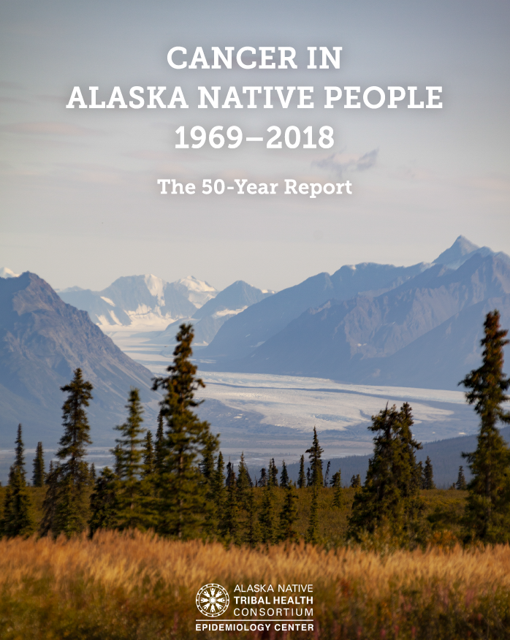
Notes:
The ANTR has been collecting cancer information for AN people going back to 1969, and every five years we put out a report on this information. We recently released the fifty year report, which is notable for several reasons:
Very few registries have this long history of surveillance. There are only a handful of registries nationwide that can share 50 years of data, so this is a rare resource that supports us in improving AN health.
This long history of surveillance means that we have a unique opportunity to see how the numbers are changing over time, and to evaluate how the programs, policies, and research that we are supporting within the Alaska Tribal Health System is impacting the cancer rates.

Slide 5
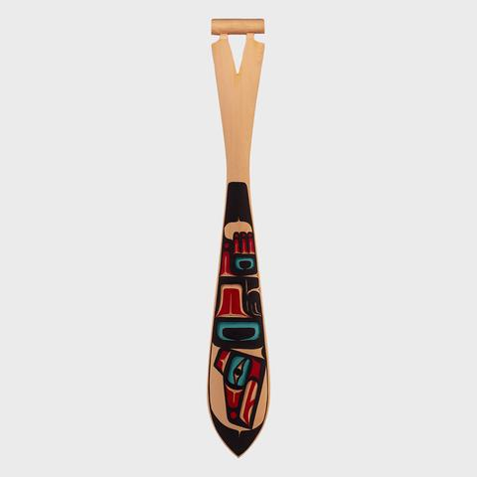
What is new in this report?
Updated data: 2014-2018
Regional rates
Leading cancers
50-year cancer trends
Cancer mortality
Notes:
The report also has a brand new look, and we’ve worked hard to make sure that the data are as accessibly presented as possible.

Slide 6
Leading cancers

Slide 7
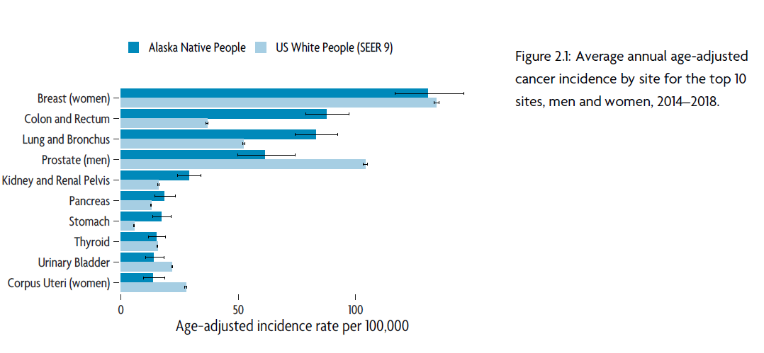
Notes:
Leading cancers:
This figure shows the top ten leading cancers among Alaska Native men and women, compared to US whites in the lighter blue.
The leading cancers have not changed between this report and the last. From 2014–2018, the most commonly diagnosed cancers were female breast (340 cases, 14% of all cancers), colorectal (405 cases, 17% of all cancers), lung and bronchus (373 cases, 16% of all cancers), prostate (126 cases, 5% of all cancers), and kidney and renal pelvis (150 cases, 6% of all cancers). This pattern is identical to the previous five-year period (2009–2013) as well as the fifty-year period 1969–2018.
One of the things that remains a key takeaway from this report is that the leading cancers are both screenable, and also somewhat preventable via lifestyle and behavior modifications.

Slide 8
Cancer trends

Slide 9
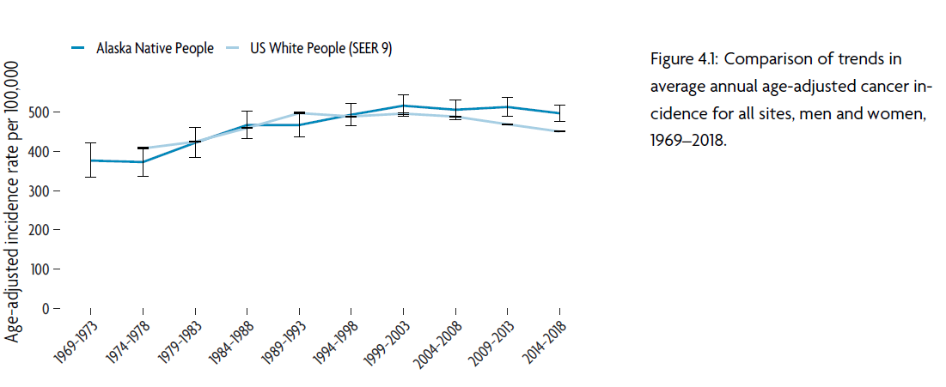
Notes:
Cancer trends:
During the five-year period 2014–2018, there were 2,401 cases of invasive cancer diagnosed among AN people, which was an increase compared to the 2,123 diagnosed during the previous five-year period 2009–2013. However, this actually represents a slight decrease in rate. This figure is showing you the trends in incidence rates for all cancers. Again, AN people are in the darker blue, and we’re comparing them here to USW in the light blue. [Explain graph]
I also wanted to note that we present in the report similar trends figures for the ten leading cancers that we saw on the previous slide, as well as for men and women separately.

Slide 10
Cancer by age

Slide 11
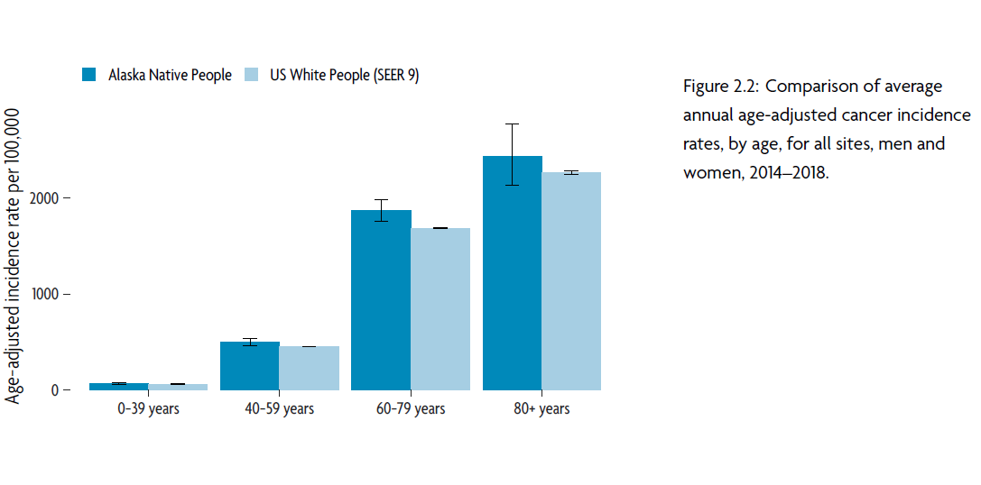

Slide 12
Cancer stage at diagnosis

Slide 13
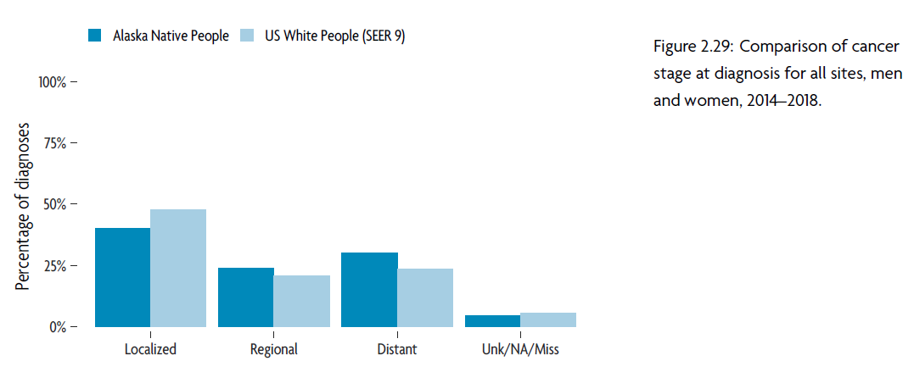

Slide 14
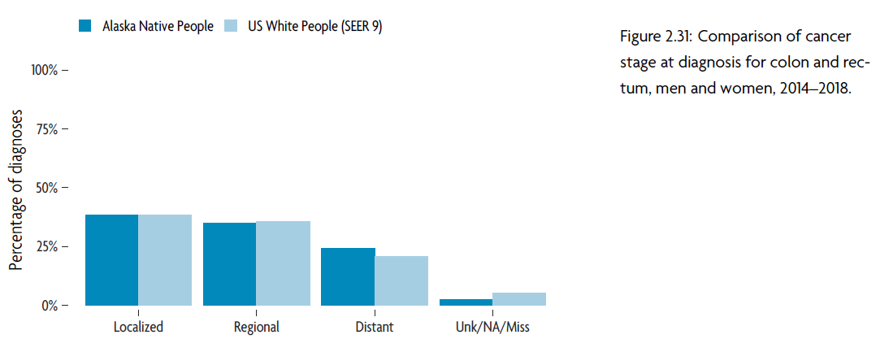
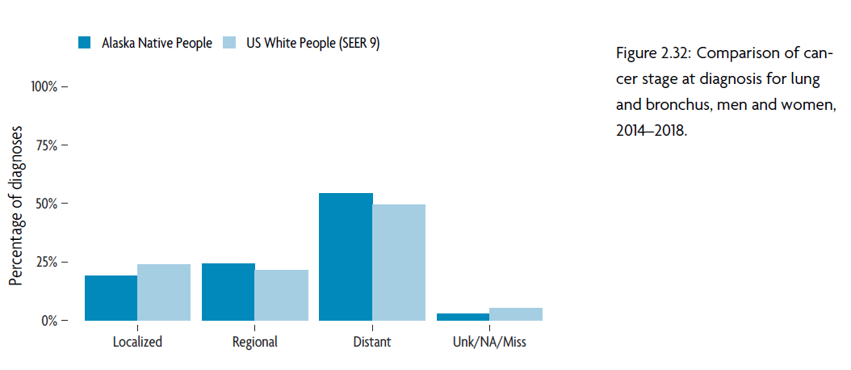
Notes:
I wanted to highlight colorectal and lung cancer by stage at diagnosis, because these are leading cancers for which a larger proportion are diagnosed at regional or late stage. For reference, over 90-95% of breast and prostate cancers are diagnosed at early stage, which is typically when cancer treatment has a greater chance of success, with lower impact on quality of life.
In contrast, you can see only about 30% of CRC are diagnosed at early stage. About 2/3 of AN people report being up to date on CRC screening, but with almost 2/3 cancer being diagnosed at regional or distant stage, this still means lots of opportunity to find those cancers earlier through screening.
You can see a similar pattern here with lung cancer – lung cancer screening with low-dose CT is less common than screening for other sites. In Alaska, about 6% of people (all races) were screened (American lung association), which is similar to the national figures. I was not able to find information specific to AN people; however, we know that prevalence of smoking is twice as high among AN people than Alaskan and US whites. In Alaska, Medicaid is not required to cover the cost of lung cancer screenings with their fee for service plan.

Slide 15
Cancer mortality

Slide 16
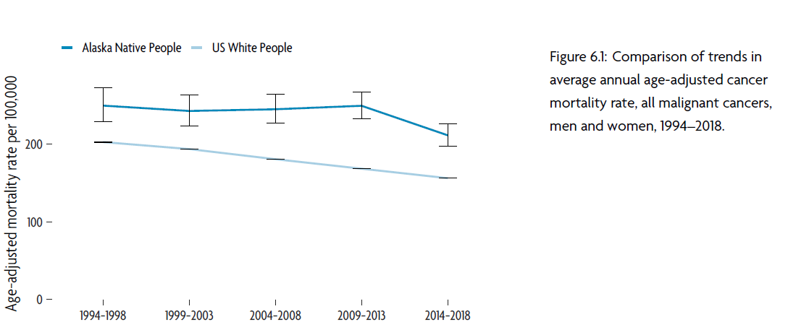
Notes:
Here I am showing you the mortality trends over time; for these figures we only have data going back to 1994. You can see over the most recent time-period that there was a decline in mortality rates. This decline was statistically significant, and equated to about 15% decline in mortality. We did see that declines in mortality from several cancer sites contributed to this overall decline, including lung cancer mortality (30% decline) and stomach cancer mortality (25% decline).
However, cancer mortality is still higher among AN people than it is among USW by about 40%.
We also have tables showing in detail 5 year and 25-year average annual age adjusted cancer mortality, so you can see more detail the rates of leading causes of cancer death, and how they have changed over time among AN people.

Slide 17
Regional information

Slide 18
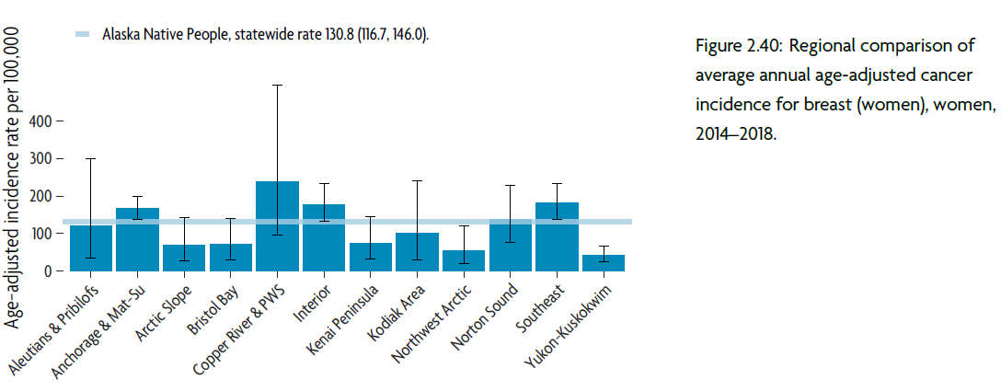
Notes:
In the leading cancers chapter (chapter 2), we have included these figures so that you can see how rates of the leading cancers vary by tribal health region.

Slide 19
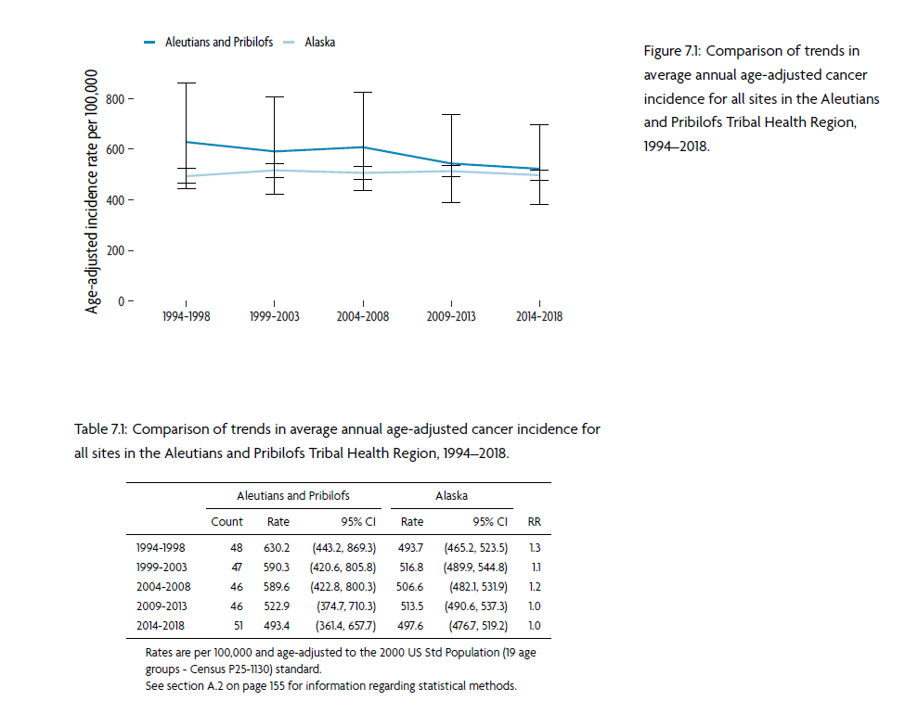
Notes:
In this chapter, we include trends and incidence data for each tribal health region. So you can see how rates of all cancers have change over time in your region.

Slide 20
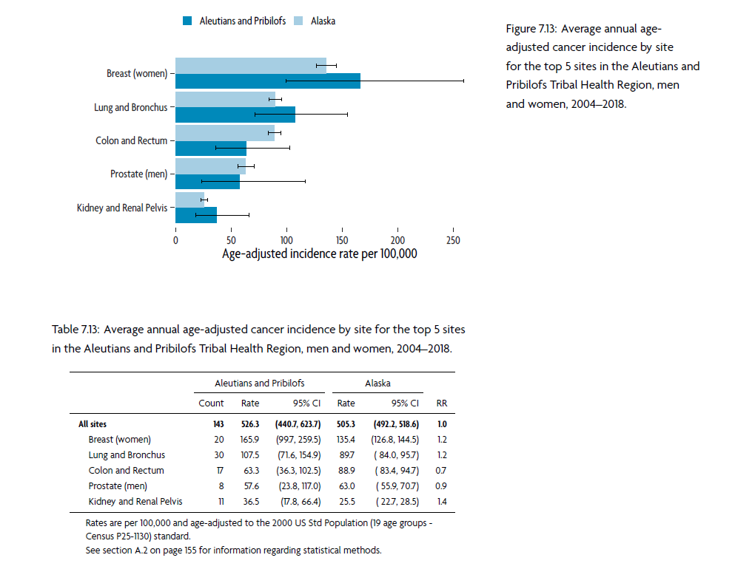
Notes:
We also give site-specific information for each region so you can see a little bit more detail on the leading cancers.
I also want to extend the offer that if there is ever any specific questions that you have, or any specific data service that you need, please do not hesitate to reach out to us at antr@anthc.org. [Give some examples of what this has looked like in the past]

Slide 21
Where can I find the report?

Slide 22
What can we do to prevent cancer in our communities?

Slide 23
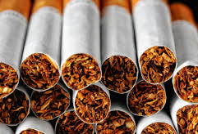
Notes:
I’d like to tell you about a study that we published looking at population attributable risk. PAR is the proportion of cancers that could potentially be prevented in a population, IF exposure to the risk factor could be eliminated. PAR may overestimate the proportion, as it does not account for interactions between the risk factors. We also did not have AK-specific risk estimates to calculate the PAR, so there might be a little wiggle room there if the relative risk for the cancer is different among AN people than among the general US population (upon whom the majority of the etiologic studies are conducted).

Slide 24
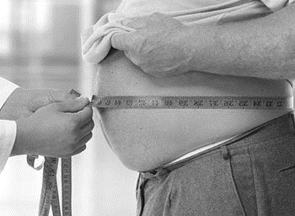
Notes:
I’d like to tell you about a study that we published looking at population attributable risk. PAR is the proportion of cancers that could potentially be prevented in a population, IF exposure to the risk factor could be eliminated. PAR may overestimate the proportion, as it does not account for interactions between the risk factors. We also did not have AK-specific risk estimates to calculate the PAR, so there might be a little wiggle room there if the relative risk for the cancer is different among AN people than among the general US population (upon whom the majority of the etiologic studies are conducted).

Slide 25
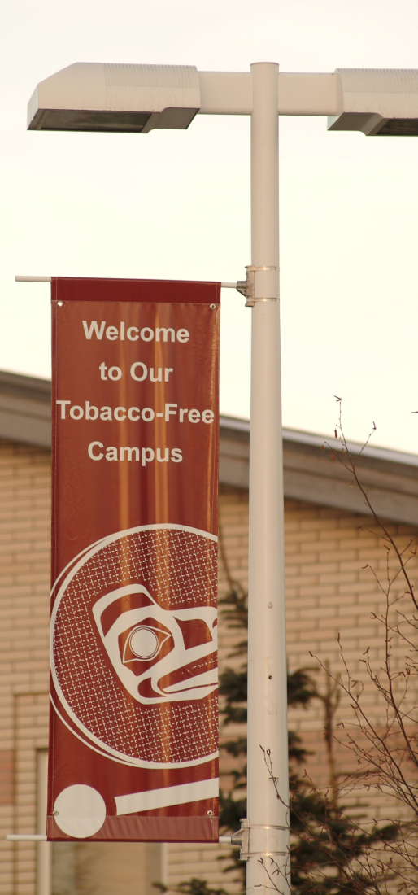
Among women: 69.8% lung cancers preventable
Alaska Native Health Campus, Anchorage
Notes:
Tobacco was the leading modifiable risk factor. Tobacco has been show to cause 13 different cancers, with evidence developing for additional cancer sites.

Slide 26
We may be able to prevent…
459 cases from 13 cancers
316 cases from 13 cancers
…If we could eliminate smoking
Notes:
From the 13 cancers known to cause smoking, we estimated that over a ten year period, we could potentially prevent 459 cases of cancer among men, and 316 cases of cancer among women. That’s a total of 775 cancers in ten years. To put that in perspective, we record somewhere between 450-500 cases of cancer a year among Alaska Native people. So, over a ten year period, we could prevent between 1.2 and 2 years worth of cases if all AN people were to be smoke free.

Slide 27
Smoking prevalence 2x higher
Data source: AK BRFSS: 2009-2017
Notes:
Unfortunately, we know this is not the case. Smoking prevalence is over twice as high among AN people than it is among AK whites. The rate is similar among AK whites to the national average. AN people also have one of the highest smoking prevalences across indigenous peoples throughout the US, as well as high smokeless tobacco use.
Smoking prevalence is 38% in the northwest arctic region

Slide 28
56% of Alaska Native people reported a quit attempt in the last year
Source: Alaska Division of Public Health, Informed Alaskans BRFSS 2013-2017
Data source: AK BRFSS: 2009-2017
Notes:
Yet, to take more of a strengths-based approach; that means that over 60% of AN people are smoke free. Furthermore, 56% of Alaska Native people reported that they had tried to quit during the last year. As clinicians and public health practitioners, we can be assisting in this effort by making sure that AN people who use tobacco have the resources that they

Slide 29
Notes:
We also found that a substantial proportion of cancers could be prevented by promoting physical activity. Epidemiologists have been learning more and more about the importance of physical activity in prevention of a variety of different diseases, as well as the harmful effects of being sedentary. Physical activity has been causally linked to five different cancers among women, and three different cancers among men. The largest prevention potential was observed majority of endometrial cancers could be prevented by engaging in physical activity. Similarly, endometrial cancer was also the cancer site that stood to see the greatest reduction in cases by reducing obesity, up to 60%. Obesity has been shown to increase the risk of ten cancers among men, and eleven cancers among women.

Slide 30
We may be able to prevent…
115 cases from 3 cancers
287 cases from 5 cancers
… with guideline-adherent physical activity levels
Notes:
Physical inactivity has been causally linked to five different cancers among women, and three different cancers among men. We estimated that approximately 402 cancers could potentially be prevented in a ten year period if all AN people were engaging in guideline adherent physical activity. CDC guidelines recommend 150 minutes MVPA per week for adults.

Slide 31
71% of Alaska Native people reported engaging in leisure time activity
Source: Alaska Division of Public Health, Informed Alaskans BRFSS 2013-2017
Data source: AK BRFSS: 2011-2015
Notes:
So what do physical activity and obesity-related statistics among AN people look like? Regarding physical activity: Over 70% of AN people reported engaging in leisure time activity, and 48% of AN people report meeting the physical activity guidelines.

Slide 32
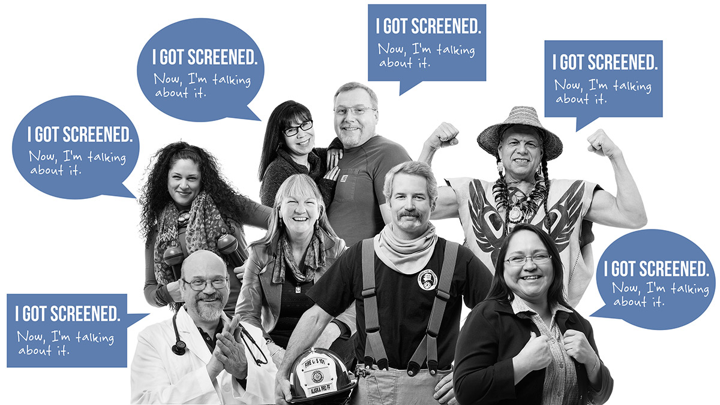
Notes:
I can’t talk about cancer prevention without talking about cancer screening. Cancer screening is one of the easiest ways to prevent certain cancers, but also to detect cancers early while they’re easy to treat, with lower impact on quality of life. There are several cancers that are screenable, including cervical cancer, female breast cancer, and colorectal cancer. And we’re just now seeing the adoption of lung cancer screening with ldCT.

Slide 33
Screening can have a huge impact on cancer rates: the case of cervical cancer

Slide 34
Healthy Alaskans goal:
61%
Proportion of Alaska Native women receiving a mammography in the last 2 years
Source: Alaska Behavioral Risk Factor Surveillance System,

Slide 35
Healthy Alaskans goal:
82%
Proportion of Alaska Native women up to date on PAP screening
Source: Alaska Behavioral Risk Factor Surveillance System, 2008-2016

Slide 36
Alaska Comprehensive Cancer Plan Goal:
80%
Proportion of Alaska Native people up to date with colorectal cancer screening
Source: Alaska Behavioral Risk Factor Surveillance System, 2010-2016
Notes:
The NWA region has the highest prevalence of up to date on CRC screening of all THRs

Slide 37
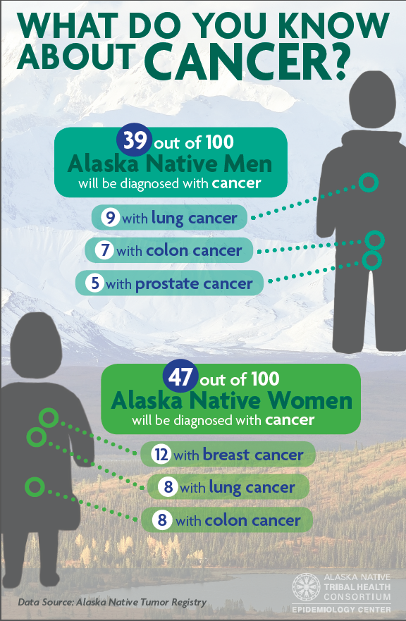
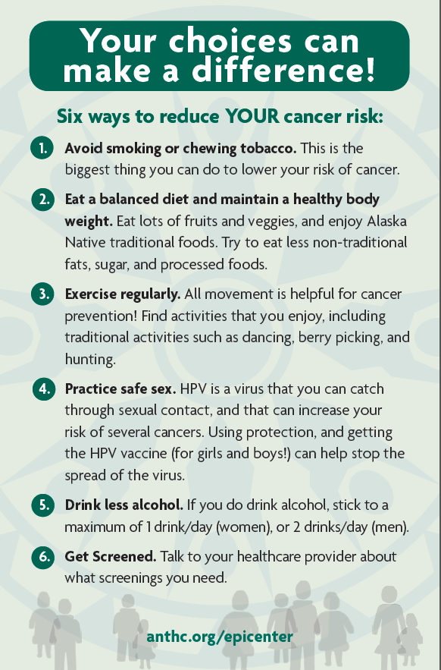

Slide 38
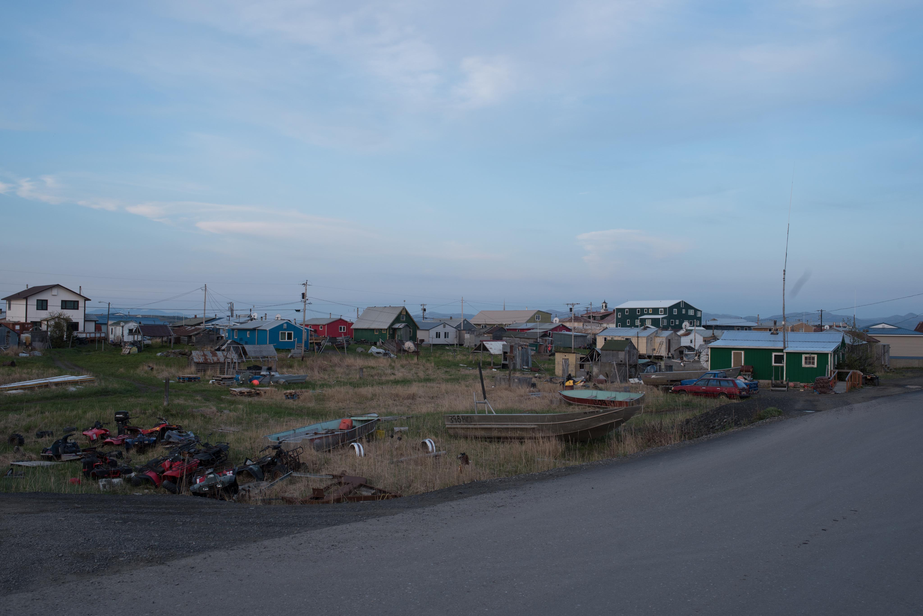
Together, we CAN prevent cancer among Alaska Native people

Slide 40
Alaska Native people have the highest rates of cancer in Alaska
Data source: Alaska Cancer Registry, 1992 - 2012

Slide 41
Alaska Native people have the highest cancer mortality in Alaska
Alaska Cancer Registry, 1996-2012
Data source: Alaska Cancer Registry

