Slide 1

Treating the ‘Alcohol’ in Alcohol-Related Liver Disease
Anne C. Fernandez PhD
Assistant Professor
Department of Psychiatry
Jessica L. Mellinger MD MSc
Assistant Professor
Division of Gastroenterology

Slide 2
Disclosures
With respect to the following presentation, there has been no relevant (direct or indirect) financial relationship between the parties listed above (and/or spouse/partner) and any for-profit company which could be considered a conflict of interest.
Funding:
Dr. Fernandez is supported by a K23 career development award from NIAAA
Dr. Mellinger is supported by a K23 career development award from NIAAA

Slide 3
Topics Covered
The context of alcohol use disorder (AUD) within alcohol-related liver disease (ALD)
How treatment of ALD patients often differs from other patients with AUD
The importance of Multidisciplinary care
Our team’s approach to multidisciplinary AUD/ALD treatment

Slide 4
Defining Drinking: How Much is Too Much?
“Healthy” Use
  Up to 1 drink/day for women, 2 drinks/day for men
Binge drinking
  >= 5 standard drinks for men, >=4 standard drinks for women on single occasion
Heavy alcohol use
  Binge drinking on 5 or more days in the past month
Alcohol use disorder
Once you have alcohol-related liver disease, any alcohol use is risky
“Dietary Guidelines for Americans: 2015-2020” Dept of Health & Human Services and Dept of Agriculture.
Kranzler HR & Soyka M, JAMA 2018;320(8)

Slide 5
Alcohol use in ALD patients
Advanced forms of liver disease develop after very heavy, regular alcohol use often over the course of years (or decades)
With some exceptions (e.g. genetic predispositions) these patients almost certainly have severe, alcohol use disorder (e.g. alcohol dependence) or moderate, alcohol use disorder. This is a chronic relapsing condition, that can be managed but not ‘cured.’

Slide 6
Our first 51 patients AUD diagnoses

Slide 7
Comorbid Substance Use Disorders are High
Notes:
Other drug use disorders are also very common in this patient population. The breakdown in this graph highlights the high prevalence of both marijuana and tobacco use disorder, but also, relatively high use disorders for other substances as well. These categories are not mutually exclusive. And this does not take into account substance use more generally, that does not make it to use disorder level

Slide 8
Mental health comorbidities are also high

Slide 9
How ALD Patients Differ from General AUD Patients
Decision to stop drinking thrust upon them by medical event
Medical health a priority (not psych health)
Don’t perceive need for treatment
Preoccupied with medical/transplant management
Don’t think they have an addiction problem
Are not addiction treatment seeking
*Courtesy of Andrea DiMartini MD (U Pittsburgh)
Notes:
Medicall urgent--. Treatment of AUD is urgent
High MELD patients.

Slide 10
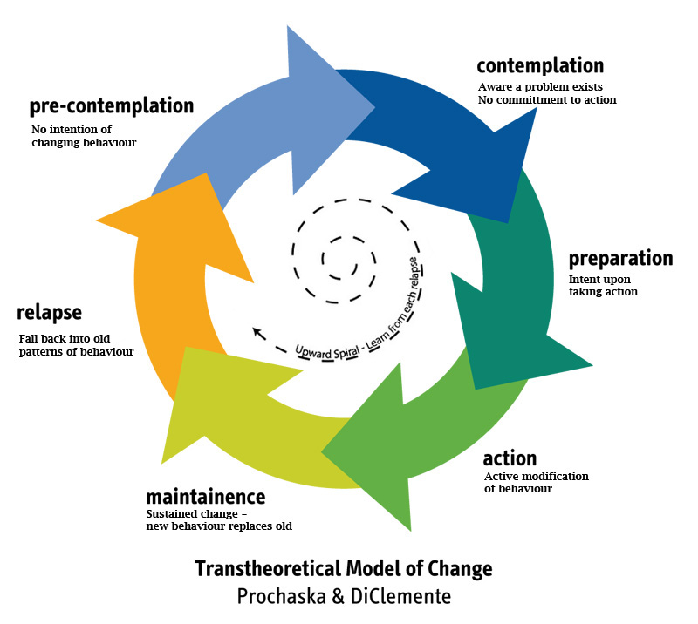
Stages of change “reverse”
Standard model
Psychological insight increases
ALD patient model
Alcohol cessation
Alcohol cessation
Psychological insight increases
Motivation gradually increases
Motivation suddenly increases
Notes:
It is almost like they are just told they have a peanut allergy, rapid and huge increase in motivation and behavior change. However, the psychological stages that would normall precede alcohol cessation don’t take place. As long as pain, discomfort and threat of death remain high, patient will likely not drink, but when a transplant takes place or the person starts to feel better, alcohol use may return swiftly; thus it is imperative to work with people to understand the AUD that underlies the ALD to truly help patients understand the nature of their alcohol use and how to maintain abstinence long-term. NOT drinking does not mean the AUD is gone! This could not be more important for patients in general, but for ALD patients in particular. This is a primary challenge for our clinic.
Patients needs ongoing, addiction care, and monitoring. Addiction is a chronic relapsing condition and these patients may not want to change, or they may change but not see the importance of ongoing addiction treatment. This is a delicate tight rope walk and isn’t typically resolved in a single clinic visit.

Slide 11
The importance of multidisciplinary care

Slide 12

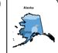
Referral to AUD treatment isn’t always so easy….
Wide geographic distances
Paucity of psych providers
  Rural = sparse
  Insurance coverage
  Saturated w/ severe pts
  Sober ALD pts “too well”
↑↑ med-psych complexity
↓ ALD expertise in community colleagues
Notes:
Simply referring patient to care is not always so easy.

Slide 13
Multidisciplinary care
Multidisciplinary, integrated SUD treatment models are key to caring for patients with complex diseases influenced by behavior, physical health, and mental health.
Hepatitis C
HIV/AIDS
Organ transplant
Diabetes
Alcohol-related liver disease
Winder GS, Fernandez A, Klevering K, Mellinger JL. Psychosomatics. 2019 Dec 19.

Slide 14
Medical silos in a health system
Discipline A
Discipline B
Discipline C
Discipline D
Discipline E
COMPLEX DISEASE X
Notes:
STATE OF AFFAIRS – MONOLITHIC STRUCTURES without much durable connection or proximity to one another
OVERSIMPLIFED, of course

Slide 15
Bring the team to the patient
Hepatology/ Medicine
Psychiatry
Psychology
Social Work
Nursing
Trainees
Cross-training, robust collaboration, strong relationships, regular meetings

Slide 16
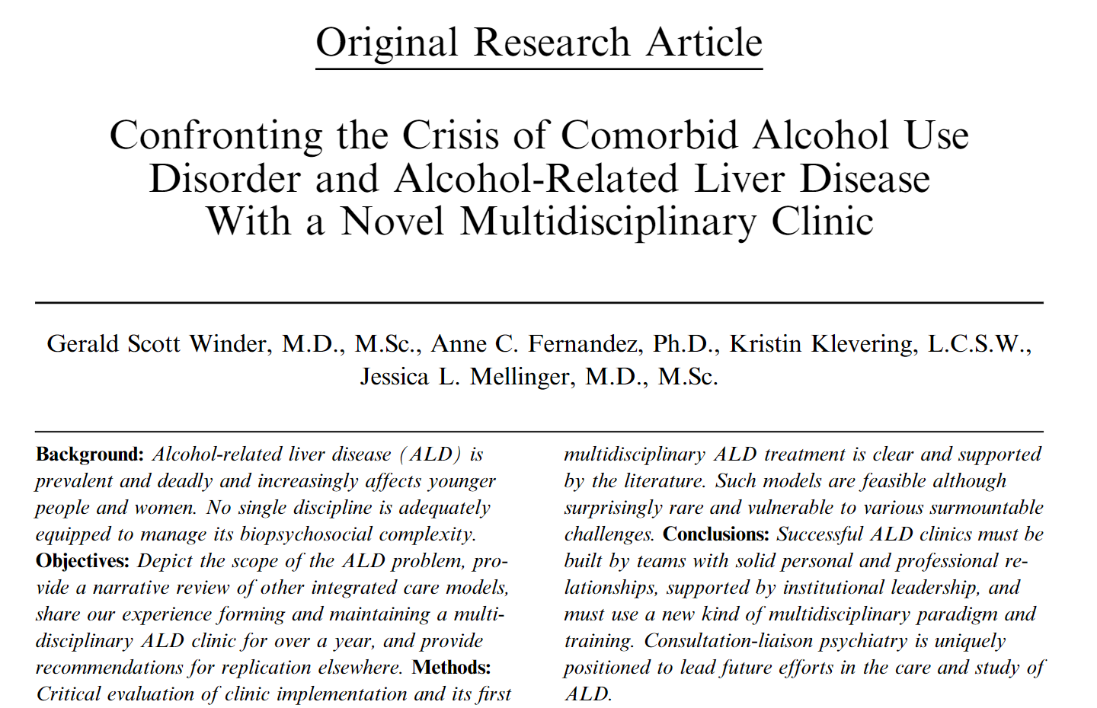
Literature on integrated SUD care

Slide 17
MAIN ALD Clinic Structure
Every other Monday
3 NPs + RVs
Pre-clinic phone call (SW)
In-clinic ALD Education Packet with RN review
See hepatology, psychiatry, either psychology or SW
Tox screens each visit and in-between
Commitment to 3 MET/CBT sessions with clinic staff
Addiction Psychology
Social Work
Psychiatry
Hepatology
Patient
Nursing
1st Year: 51 patients Outcomes: Liver, AUD, Cost/Value
Notes:
Are we making the best use of the organ?
Patient/graft survival

Slide 18
Why multidisciplinary could help AI/AN populations
Native Americans/Alaska Natives are more likely to need alcohol or illicit drug use treatment than persons of any other ethnic group (not due to highest overall use, but highest severe use).
The Substance Abuse and Mental Health Services Administration reports that 13% of Native Americans need substance use treatment, but only 3.5% actually receive any treatment.
Substance Abuse and Mental Health Services Administration. (2019). 2018 National Survey on Drug Use and Health Detailed Tables.
Dickerson, D.L., Spear, S., Marinelli-Casey, P., Rawson, R., Li, L., & Hser, YI. (2011). American Indians/Alaska Natives and Substance Abuse Treatment Outcomes: Positive Signs and Continuing Challenges. Journal of Addictive Diseases, 30(1), 63–74.

Slide 19
AI/AN populations may have face more treatment barriers
Some treatment barriers disproportionately influence AI/NA communities
  Lack of treatment resources in rural areas
  Lack of insurance
  Lack of transportation
  Access to telehealth??
  Less access to evidence-based treatments
  Lack of culturally-appropriate treatment services that recognize NA/AI identity and the diversity within NA/AI communities and tribes

Slide 20
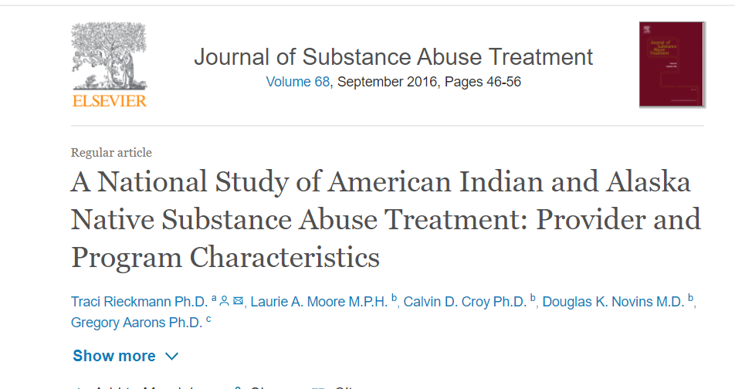
For additional information…
https://www-sciencedirect-com.proxy.lib.umich.edu/science/article/pii/S0740547215300866?via%3Dihub

Slide 21
Goals of Multidisciplinary Care

Slide 22
Relationship Building:
Between Visit Touches
  Pre visit calls to orient them to the clinic visit, answer questions, and trouble shoot for barriers to attending.
  After visit calls to ask about medication compliance and to make sure follow up appointments are scheduled, resources have been provided, and answer any questions.
  Between visit calls to check in and follow up.

Slide 23
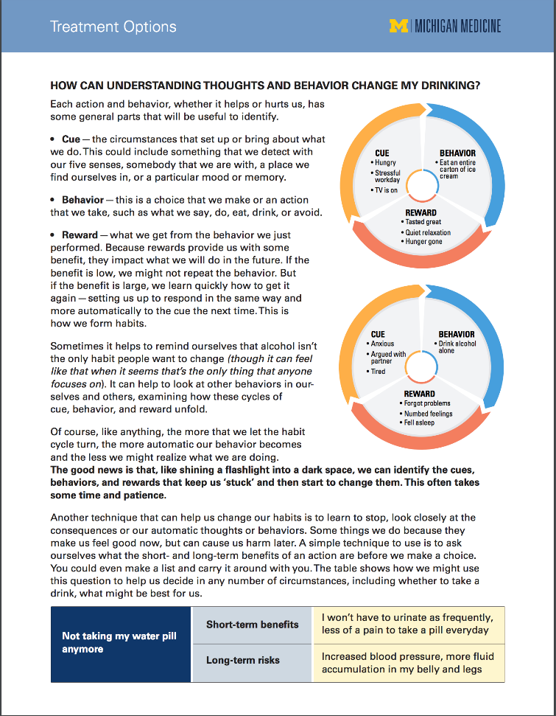
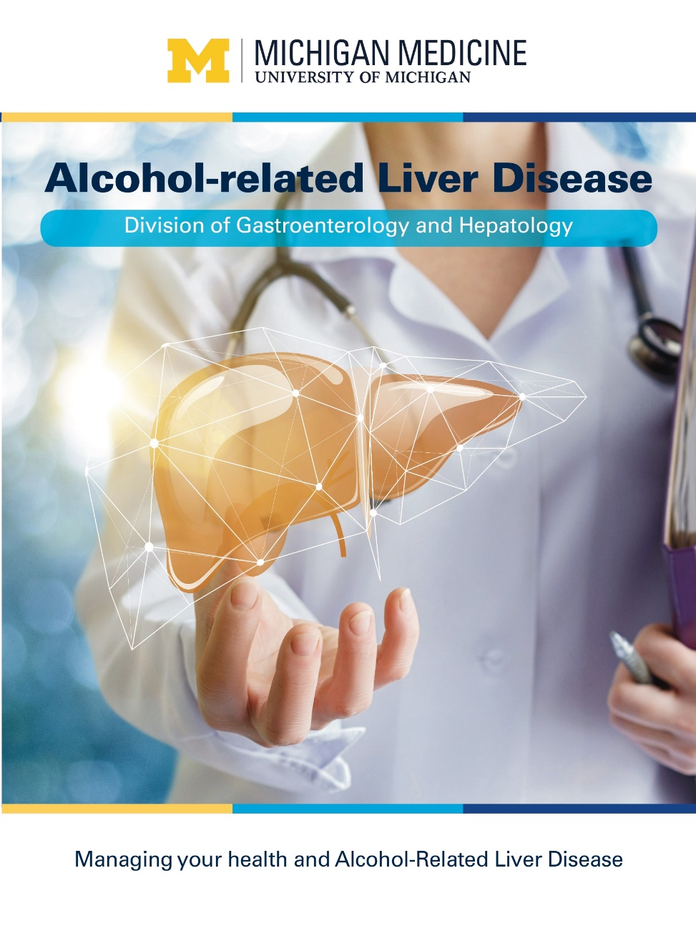
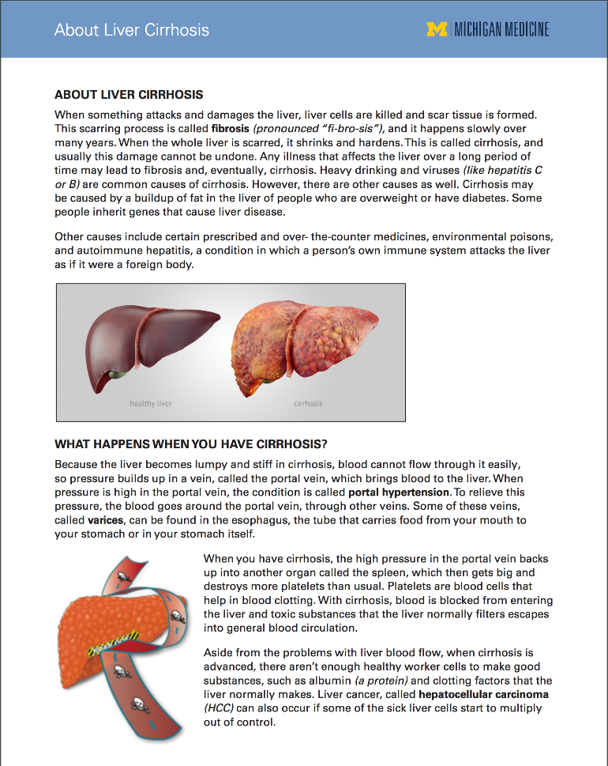
ALD Clinic Educational Materials

Slide 24
Social Worker trained in Addictions and Case Management
Has clinical training and experience in treating patients with Substance Use Disorders
Works on identifying and reducing barriers to care for patients
Knows resources and can make referrals

Slide 25
Motivational Interviewing
The Spirit of MI - communicating compassion, acceptance, partnership, and respect - sets the tone for the interview with these complex and challenging patients.
Recognizing that ambivalence is normal, even expected, with this population.
Emphasizes the power of choice, as this population feels they have lost this with their diagnosis.
Framework for providing information about treatment with the patient’s permission, rather than putting it upon them as it may have been by previous providers.

Slide 26
Individual Therapy Visits
We ask all patients to participate in 3 sessions of therapy with the Psychologist or Social Worker in the clinic.
  Many patients have not engaged in therapy before, or had bad experiences. This opens that door for these individuals can commit to.
  Gives us the chance to get to know the patient better, provide psychoeducuational, find out what motivates them, and to refer them to appropriate resources in their area.
  Many patients live far away, these visits can be scheduled as telehealth visits (now that this is approved by insurance)

Slide 27
Referrals for Treatment
Many of our patients live over an hour away from our clinic.
Each Health Insurance plan determines what kind of treatment and where the patient can get treatment.
Medicaid/Medicaid HMO patients have limited options.
Our clinic can only provide outpatient, time-limited care
Treatment resources are scarce.

Slide 28
American Indian/Alaska Native AUD treatment resources
  Wellbriety : www.wellbriety.com
  Indian Health Service – alcohol and substance abuse programs www.ihs.gov/asap
  AA for Native Americans www.naigso-aa.org
  Promising practices to reduce alcohol and substance use among AI/NA individuals
    http://wellbriety.com/wellbriety/wp-content/uploads/2019/06/Promising-Practices-Strategies-Reduce-Alcohol-Substance-Abuse.pdf
  Supporting sobriety among AI and NA: a literature review
    uihi.org/wp-content/uploads/2014/02/Supporting-Sobriety_A-Literature-Review_WEB.pdf

Slide 29


Creativity and Persistence
Anne
The hepatolgist (or PCP) will bring patients in… (honey), so link the psych visits
Use between clinic ‘touches’
Start with a small “ask”
Make clinic appointment policies clear and concrete
Warm hand-offs
“ambush psychiatry”
Kristin
Scott
Notes:
Another lesson is that this work takes creativity and persistence. We have had problem areas.
No shows, these are complex patients with multiple disordres are frequently inpatient, and have waxing and waning motivation
We also found that Dr. Mellinger is the person most patients primarly come to see, and sometimes we have to be the flies buzzing around the honey, essentially seeing the patients when they come to see Dr. Mellinger, and that is OK
We found early on we asked for too much treatment engagement from patients, like a 12-session CBT level. We got better engagement when we asked people to commit to three visits
Finally, make clinic appts policies clear and concrete

Slide 30
Take-aways
Severity of AUD and psychiatric comorbidities is high in ALD patients
Their needs are complex and not well-served in one clinic visit with one provider type
There is a need for multidisciplinary care AUD/ALD patients
Most patients DO come to initial mental health visits, some engage in more intensive treatment, and some stop drinking!
AUD treatment engagement and alcohol cessation in this population is a huge challenge that requires creativity, persistence, patience, and relies heavily on “the heroism of incremental care.”
Gawande (2017) The Heroism of Incremental Care, The New Yorker

Slide 31
Questions

