Slide 1


Slide 2
HIPAA and Privacy
Training
Allison Reed
ANTHC Ethics and Compliance
July 2019

Slide 3
Today’s Plan
Review HIPAA requirements
Discuss laws that govern health record privacy
Become familiar with some common terms
Talk about our privacy obligations
Explain how we can keep information safe

Slide 4
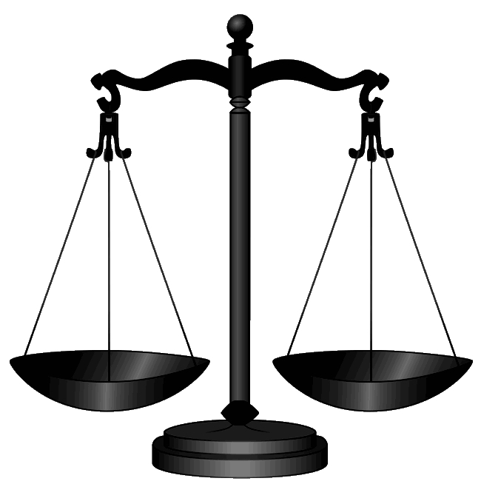
What laws protect health records?
Maintaining privacy of health records is governed by many laws and regulations:
HIPAA
The HITECH Act
42 C.F.R. Part 2-Substance Abuse Records
Federal Privacy Act (5 USC § 552a (b))
State law

Slide 5
HIPAA
HIPAA is an acronym that stands for the Health Insurance Portability and Accountability Act of 1996
HIPAA applies to Doctors, employees of health care organizations, students, volunteers, contractors and vendors
HIPAA Penalties:
  HIPAA Civil Penalties
  $100 - $25,000 / year fines; More fines if multiple year violations.
  HIPAA Criminal Penalties
  $50,000 - $1,500,000 fines; Imprisonment up to 10 years.
  State Laws
  Fines and penalties apply to individuals as well as health care providers, up to a maximum of $250,000; may impact your professional license.
    Imprisonment up to 10 years.

Slide 6
HIPAA governs
Protected Health Information (PHI)
PHI is a subset of health information that is:
created or received by a health care provider
related to the past, present, or future health of an individual
related to the past, present or future payment for the provision of health care to an individual
Identifying information
Demographic information

Slide 7
What is “Identifying Information”?
Name
Address (all geographic subdivisions smaller than state, including street address, city county, and zip code)
All elements (except years) of dates related to an individual (including birthdate, admission date, discharge date, date of death, and exact age if over 89)
Telephone numbers
Fax number
Email address
Social Security Number
Medical record number
Health plan beneficiary number
Account number
Certificate or license number
Any vehicle or other device serial number
Web URL
Internet Protocol (IP) Address
Finger or voice print
Photographic image – note images are not limited to images of the face
Any other characteristic that could uniquely identify the individual

Slide 8
HIPAA is broken into 3 Rules
Privacy
Security
Breach Notification

Slide 9

HIPAA Rule #1:
Privacy Rule
Establishes national standards to protect individuals’ medical records and other PHI
Requires appropriate safeguards to protect the privacy of PHI, and sets limits and conditions on the uses and disclosures that may be made of such information without patient authorization
The Rule also gives patients rights over their health information, including rights to examine and obtain a copy of their health records, and to request corrections

Slide 10

How do patients know their rights?
Healthcare facilities must have a Notice of Privacy Practices (NPP)
Each patient should receive a copy of the NPP at the time that they first receive treatment and again whenever the NPP is substantively changed
The NPP should be posted in patient areas and on your website

Slide 11
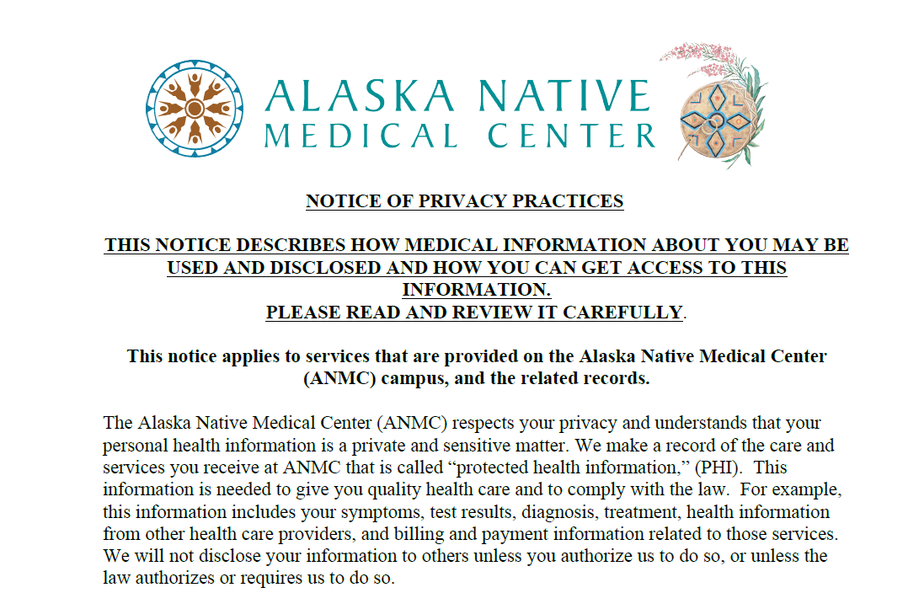
Notice of Privacy Practices

Slide 12
Privacy Rule: Patient Rights and Requests
Always document request and response, especially denials
Confidential Communications
  Alternative means
  Alternative locations
Restrict or prohibit disclosures
  Implementing
  Terminating
Access PHI
  Fees

Slide 13
Identifying Patient Rights
Request Amendment
Request Restriction
“Um, I am not an alcoholic, I can’t believe my record says that.”
“Can you not tell my daughter about this? I know she helps me with medicine, but I don’t want her to know.”

Slide 14
What to do when you recognize a privacy right request?
Provide the individual with the appropriate forms to make the request, but if they want to use their own form, that is permitted
Let the Privacy Officer know if you think a privacy right was triggered and the customer-owner was not offered the opportunity to exercise their right.
Complaints are often hidden privacy right requests.

Slide 15
Records Requests by Patients
Verify Identity
Verify authority of parent or personal representative
Remember Patient Rights
Reasonable Charges OK
Questions to ask:
  Paper or Electronic?
  Danger to themselves?
Notes:
Carolyn

Slide 16

One of the ways that we protect privacy is by following the “Minimum Necessary” Standard
  Only Workforce Members with a legitimate need to know for the performance of their job duties shall access health records, and then only the minimum necessary to complete the task at hand.
  Disclosures of PHI must be limited to the minimum necessary required to fulfill a particular purpose or request.
  Does not apply in all situations: treatment; disclosures to patient or pursuant to patient authorization; disclosures
  for enforcement purposes; disclosures required by law, etc.

Slide 17
We also protect privacy by limiting disclosures to those authorized by the patient, or by law.
Is it ever okay to share PHI without patient authorization?
Permitted Uses and Disclosures for PHI
  Treatment
  Payment
  Health Care Operations
  Other exceptions?
  Public Health Laws, Protective Services

Slide 18

Health Care Operations
Certain administrative, financial, legal, and quality improvement activities of a covered entity that are necessary to run its business and to support the core functions of treatment and payment

Slide 19

Is this an appropriate use of PHI?
The Alaska Native Medical Center
As your patient is leaving her appointment you stop her and take a quick selfie to show your roommate a photo of the patient that is had a remarkable recovery from cancer.

Slide 20
Remember, HIPAA protects PHI, which includes, identifying information.
What is “Identifying Information”?
Name
Address (all geographic subdivisions smaller than state, including street address, city county, and zip code)
All elements (except years) of dates related to an individual (including birthdate, admission date, discharge date, date of death, and exact age if over 89)
Telephone numbers
Fax number
Email address
Social Security Number
Medical record number
Health plan beneficiary number
Account number
Certificate or license number
Any vehicle or other device serial number
Web URL
Internet Protocol (IP) Address
Finger or voice print
Photographic image - Photographic images are not limited to images of the face.
Any other characteristic that could uniquely identify the individual

Slide 21
Answer
Photographic images are identifying information that must be kept confidential.
Storing such information on a mobile phone that does not have the protections in place to keep PHI confidential and secure is a violation.

Slide 22
Take away point for the Privacy Rule
Only deal with what you have to, when you have to:
Don’t look at information, unless you need it for your job duties
Don’t share information, unless its necessary or if the patient has authorized the disclosure
There are exceptions, but this is a good starting point

Slide 23

HIPAA Rule #2: Security Rule
The Security Rule establishes national standards to protect individuals’ electronic PHI (ePHI) that is created, received, used, or maintained by a covered entity.
The Rule requires appropriate administrative, physical and technical safeguards to ensure the confidentiality, integrity, and security of ePHI.

Slide 24
Physical Safeguards
Our First Line of Defense
  All Facilities, housing records, or devices that store or can access records, must be locked after hours.
  Only authorized personnel should have keys to those facilities - keys or keycards must be turned in or turned off immediately upon separation, or the corresponding lock(s) or codes changed.
  May limit access to particular facilities or high security areas based on a Workforce Member’s role and function.
  Visitors to the facility (this included drug reps and vendors) not allowed in secure areas, monitored at all times and never left alone with access to health records, whether in paper or electronic form.
  All physical repairs and modifications to a facility related to security (e.g., walls, doors, and locks) documented and transmitted to the Security Officer (IT Director).

Slide 25

Which information has to be secured?

Slide 26

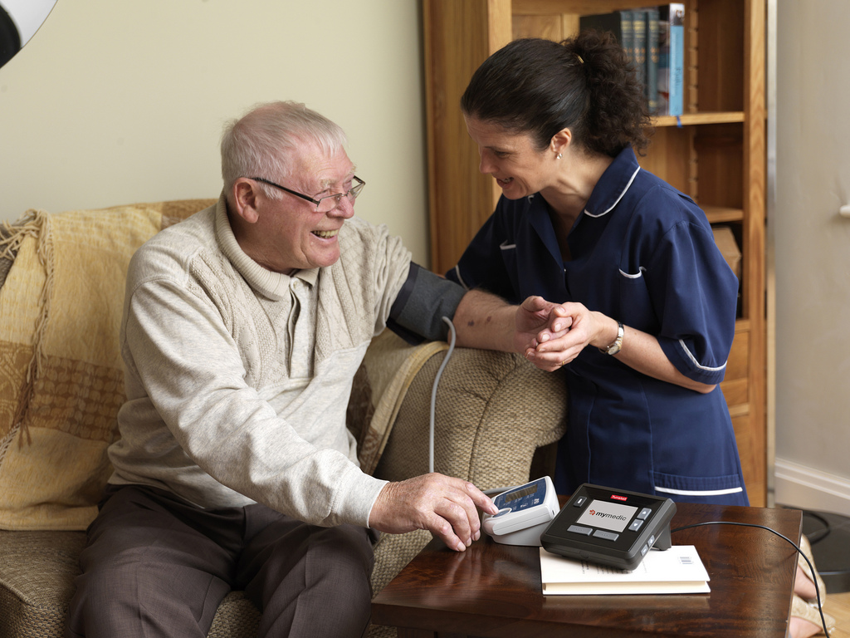
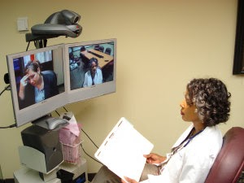
Protected Health Information (PHI)
PHI exists in various forms….
  printed spoken electronic
Protecting ALL forms of PHI is the responsibility of every employee

Slide 27

How can I protect PHI in my physical workspace?
Keep all documents with PHI (including photos, videos, X-rays) in a secured location
Limit access to areas with PHI to individuals who have a role or function in patient care
Visitors, including workers, should not be allowed in secure areas without supervision. Monitor areas with PHI at all times

Slide 28

Be Aware
Be aware of PHI around you to avoid
unintentional use or disclosure:
Examples:
Papers on desks
Computer screens visible
Conversations involving patients
Patient information on stickers, medication labels, forms
Photos or videos that you could potentially capture on your personal phone

Slide 29
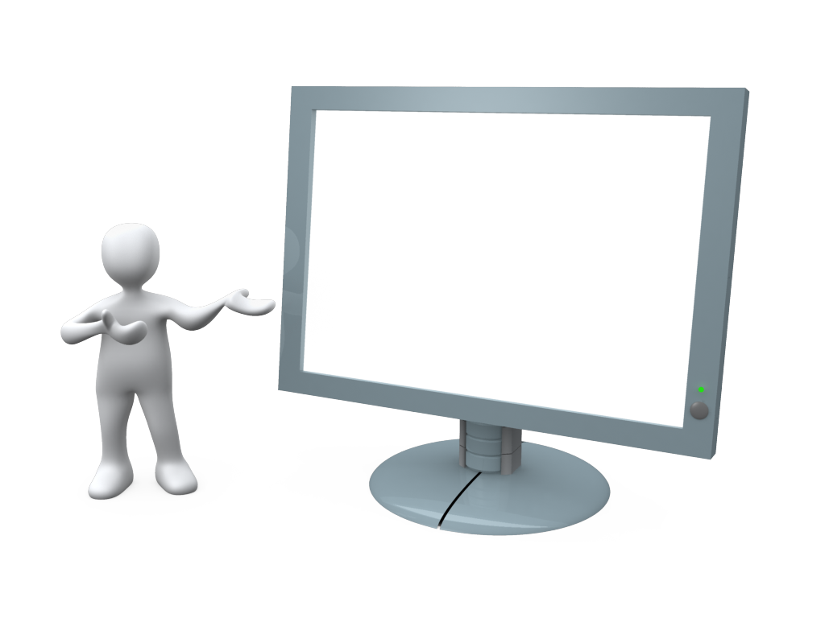
How can I protect PHI in an electronic health record?
Lock your computer whenever you leave it unattended
Laptops or tablets with PHI must be kept in a secure location—including while in transit.
Laptops and tablets must have encryption software installed

Slide 30

Protect Usernames and Passwords
Never give your username and password to anyone!
Never write your password down!
Don’t stick password to monitor or keyboard
Don’t give out your personal information
Treat your password like your ATM card PIN

Slide 31

Mobile Devices
ANTHC does not allow patient information to be stored on personal mobile devices. This applies to all mobile computing devices such as laptop computers, tablets, cell phones, or personal thumb drives.
  NEVER leave laptops or other mobile devices unattended in unsecured areas.
  IMMEDIATELY report the loss or theft of any mobile computing device to your supervisor and the Compliance Officer.
  REMEMBER, for any mobile device with PHI, encryption is the best defense!

Slide 32



Shredding
DO NOT put personally identifiable information in the trash or recycle bin
Shred it!

Slide 33

HIPAA Rule #3:
Breach Notification Rule
The Breach Notification Rule requires covered entities (ANMC) and their business associates to provide notification following a breach of unsecured PHI.

Slide 34

If you think an inappropriate disclosure of PHI has occurred:
Immediately report it to your supervisor and the Compliance/Privacy Officer of your organization
Review your HIPAA policies and procedures
Examples:
Documents with PHI are missing or lost
A fax or email is sent to the wrong address
Paperwork is given to the wrong person
There is a break-in or theft
If you think your computer was hacked

Slide 35
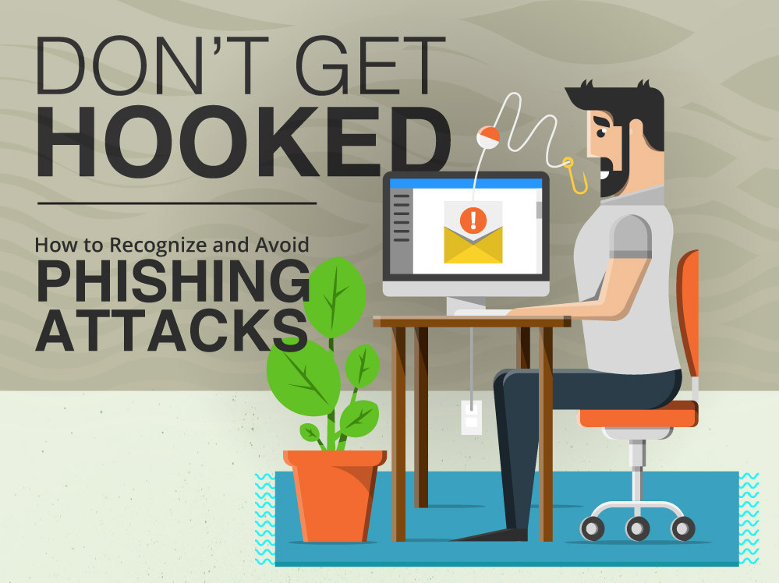
Phishing Attacks are the new Breaking and Entering!
Phishing Attacks are malicious emails that are sent to steal information, to obtain access to a computer system, or to infect a computer system.
Note, Ransomware Attacks are often start with Phishing Attacks.

Slide 36


How to spot a Phishing Email
Typos, grammar, spelling, or punctuation errors
Vague or impersonal greeting
No identification of sender
Implausible pretexts
Urgent language
Links to unknown or suspicious web addresses

Slide 37

What should you do?
  Be suspicious of any email that you were not expecting.
  Does it seem plausible that this is a legitimate email?
  Hover mouse over email address. Does it match address that is displayed?
  If an email sender seems legitimate but the email seems unusual, take the time to call the sender and verify.

Slide 38
Quiz
https://create.kahoot.it/login

Slide 39


Slide 40
Contact Information
ALLISON REED
Alaska Native Tribal Health Consortium
Senior Compliance Specialist
729-1992
ahreed@anthc.org

Slide 41


